Slide 1
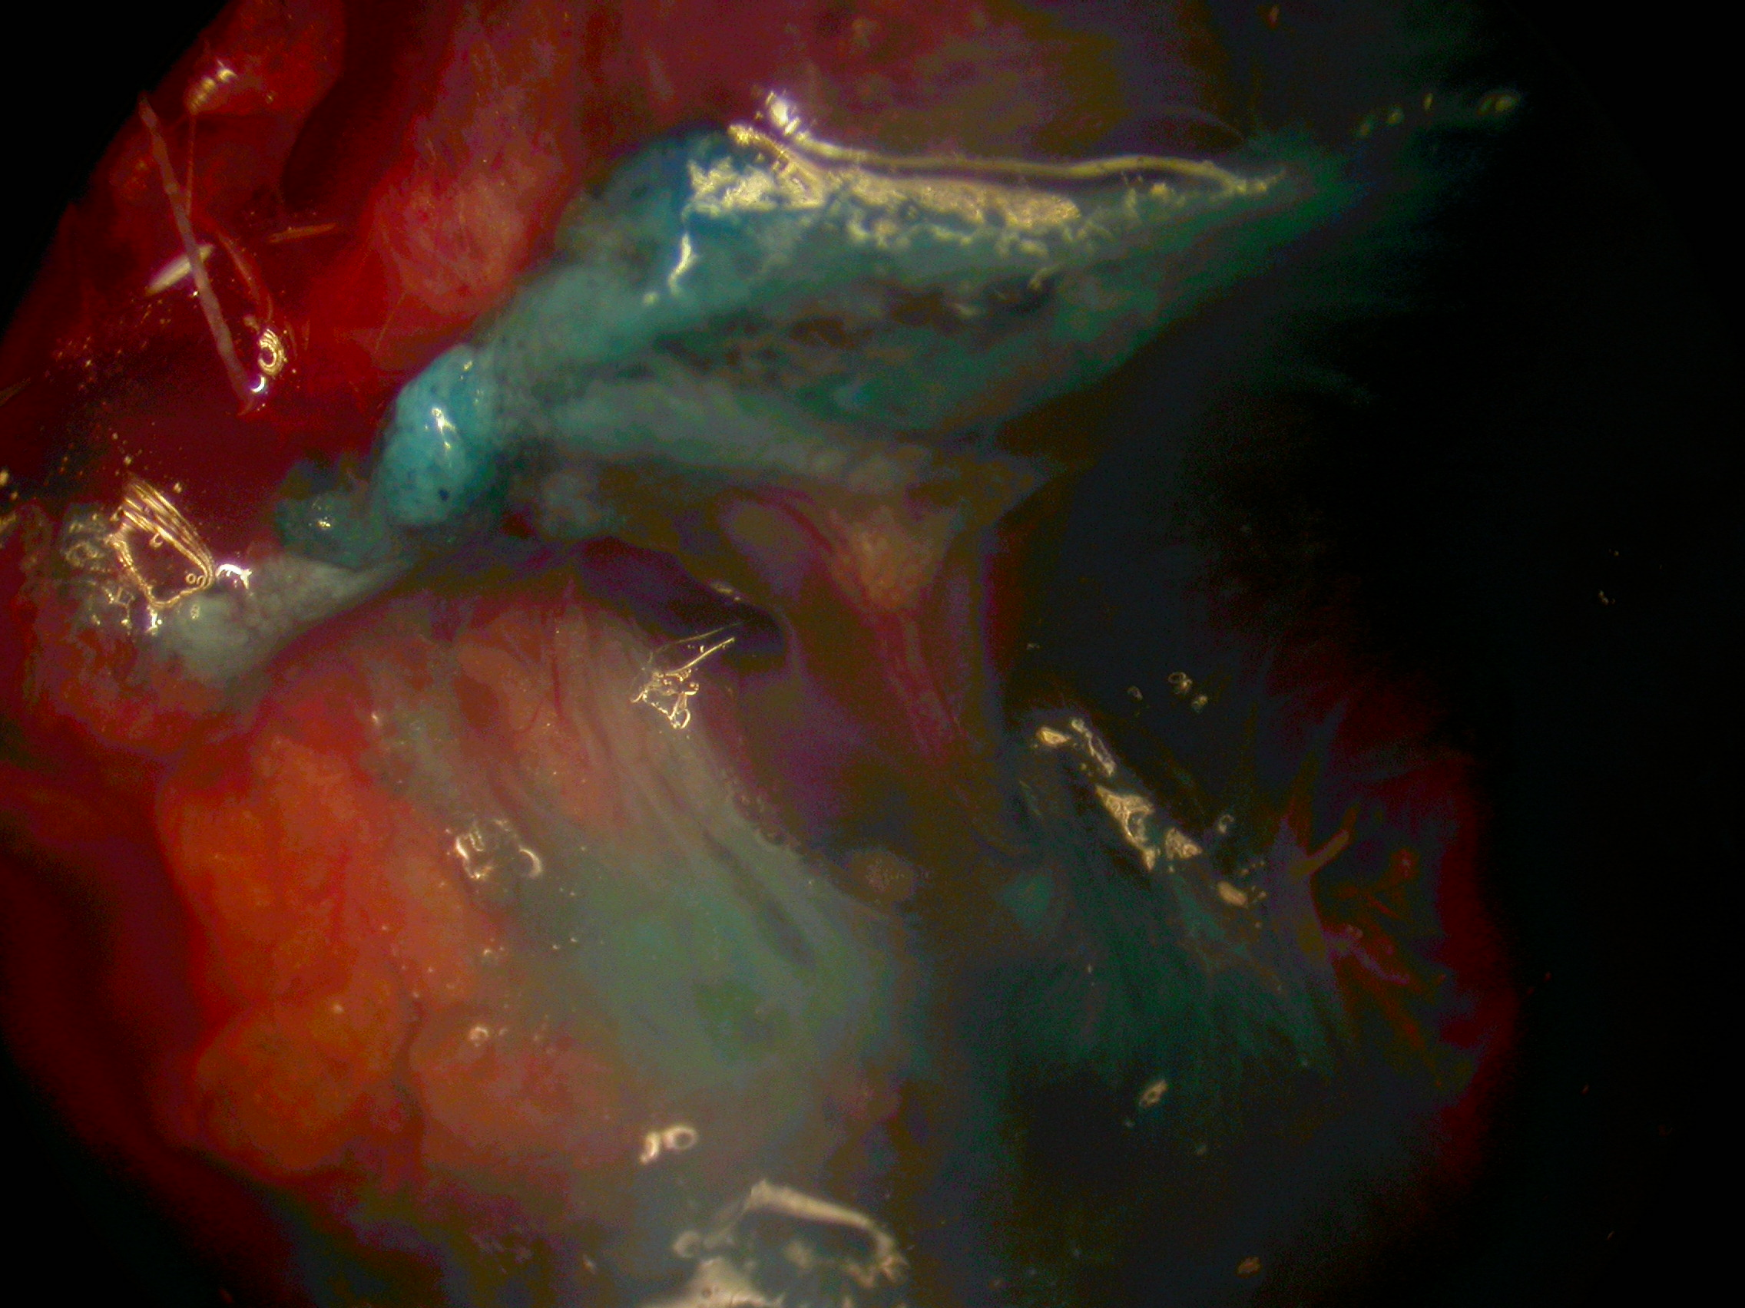
PARATIROIDE
RLN

Slide 2
Potential role for carbon nanoparticles identification and preservation in situ of parathyroid glands during total thyroidectomy and central compartment node dissection
Jialei Gu,* Jiafeng Wang,* Xilin Nie, Wendong Wang, and Jinbiao Shang
Departments of Head and Neck Surgery, Zhejiang Cancer Hospital, Wenzhou Medical University, China
Address correspondence to: Jinbiao Shang, Department of Head and Neck Surgery, Zhejiang Cancer Hospital, Whenzhou Medical University, No. 38 Guangji Road, Hangzhou 310022, China. E-mail: moc.361@codoaibnijgnahs
*Equal contributors.

Slide 3
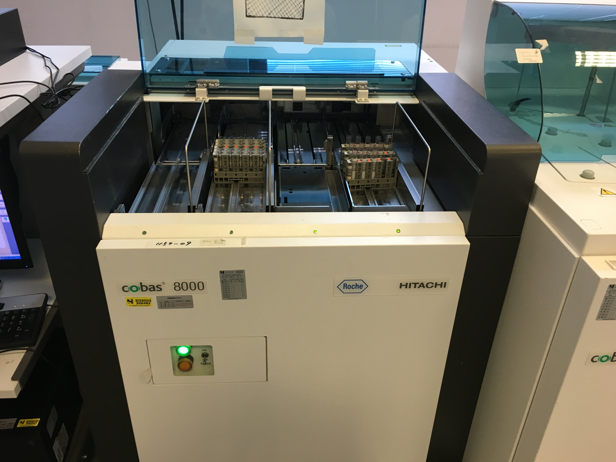
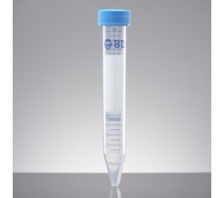
IPOCALCEMIA Ca < 8 mg\dl
NADIR DELLA IPOCALCEMIA E’ 48-72h DOPO INTERVENTO - TIMING DEI SINTOMI EVIDENTI
PTH Valori Normali = 15 – 65 pg\ml
RAPIDA EMIVITA DEL PTH CONSENTE IL DOSAGGIO IN RECOVERY ROOM O DAY SURGERY UNIT.
PTH = 18 minuti

Slide 4


Houlton JJ (2011)
PACU-PTH > 30 pg\ml = ONE day surgery - no terapia
PACU–PTH tra 20 – 30 pg\ml = ONE day surgery + terapia
PACU-PTH < 20 pg\ml = Ricovero + terapia
PTH alla 4h postoperatoria

Slide 5
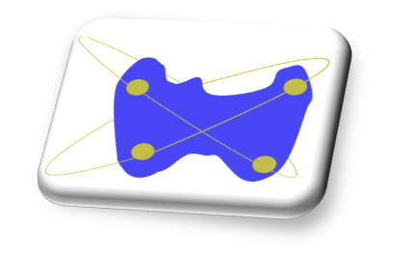
EMORRAGIA – EMATOMA POSTOPERATORIO
INCIDENZA DA 0.6 a 2.1 %
50% ENTRO LE 6 h POSTOPERATORIE
> 20 % TRA LA 7 h E 23 h POSTOPERATORIA
< 20 % OLTRE LA 24 h POSTOPERATORIA + FREQUENTEMENTE EMATOMI O RACCOLTE STABILI

Slide 6
Complications after thyroid gland operations in Germany
A routine data analysis of 66,902 AOK patients
Chirurg
DOI 10.1007/s00104-016-0267-1
© Springer-Verlag Berlin Heidelberg 2016
M. Maneck1 · C. Dotzenrath2 · H. Dralle3 · C. Fahlenbrach4 · R. Paschke5 ·
T. Steinmüller6 · E. Tusch7 · E. Jeschke1 · C. Günster1
1Wissenschaftliches Institut der AOK, Berlin, Deutschland
2 Klinik für Endokrine Chirurgie, Helios KlinikumWuppertal,Wuppertal,Deutschland
3Universitätsklinik für Allgemein-, Viszeral- und Gefäßchirurgie, Universitätsklinikum Halle (Saale), Halle
(Saale), Deutschland
4AOK-Bundesverband, Berlin, Deutschland
5 Klinik für Endokrinologie und Nephrologie, Universität Leipzig, Leipzig, Deutschland
6 Zentrum für Endokrine Chirurgie, DRK Kliniken Berlin/Westend, Berlin, Deutschland
7Medizinischer Dienst der Krankenversicherung Berlin-Brandenburg, Berlin, Deutschland
PARALISI VOCALE PERMANENTE = 1,5%
EMORRAGIA – EMATOMA = 1,8%
INFEZIONE = 0,4 %

Slide 7
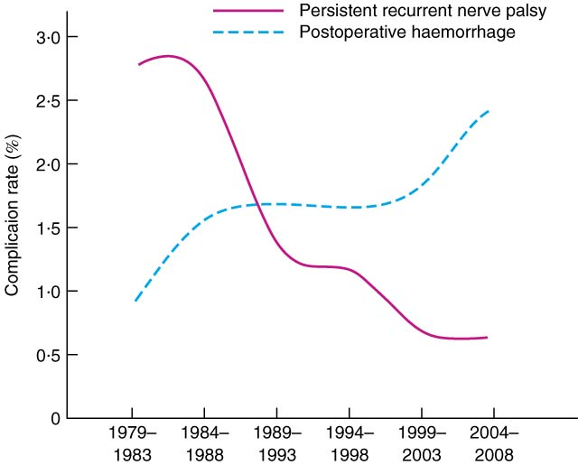
Risk factors for postoperative bleeding after thyroid surgery
British Journal of Surgery
Volume 99, Issue 3, pages 373-379, 9 JAN 2012 DOI: 10.1002/bjs.7824
http://onlinelibrary.wiley.com/doi/10.1002/bjs.7824/full#fig1
Promberger R……e al. N = 30142 Tiroidectomie
Notes:
7
Time‐dependent changes in postoperative bleeding and persistent recurrent laryngeal nerve injury. Complication rates were calculated for consecutive 5‐year intervals
IF THIS IMAGE HAS BEEN PROVIDED BY OR IS OWNED BY A THIRD PARTY, AS INDICATED IN THE CAPTION LINE, THEN FURTHER PERMISSION MAY BE NEEDED BEFORE ANY FURTHER USE. PLEASE CONTACT WILEY'S PERMISSIONS DEPARTMENT ON PERMISSIONS@WILEY.COM OR USE THE RIGHTSLINK SERVICE BY CLICKING ON THE 'REQUEST PERMISSIONS' LINK ACCOMPANYING THIS ARTICLE. WILEY OR AUTHOR OWNED IMAGES MAY BE USED FOR NON-COMMERCIAL PURPOSES, SUBJECT TO PROPER CITATION OF THE ARTICLE, AUTHOR, AND PUBLISHER.

Slide 8
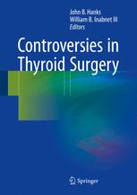

Slide 9
Consigli di buona pratica chirurgica:
EMOSTASI ACCURATA - MANOVRA DI VALSALVA
CORRETTO UTILIZZO DI ENERGY BASED DEVICES
SUTURA SOLO PARZIALE DEI MM. PRELARINGEI E DRENAGGIO ????
CONTROLLO DI TOSSE – NAUSEA – VOMITO
MEDICAZIONE NON COMPRESSIVA – SOLO STERI STRIP – EVIDENZA RAPIDA DI RACCOLTE
BEDSIDE DECOMPRESSION PRIMA DI TENTARE L’INTUBAZIONE

Slide 10
